Slide 1
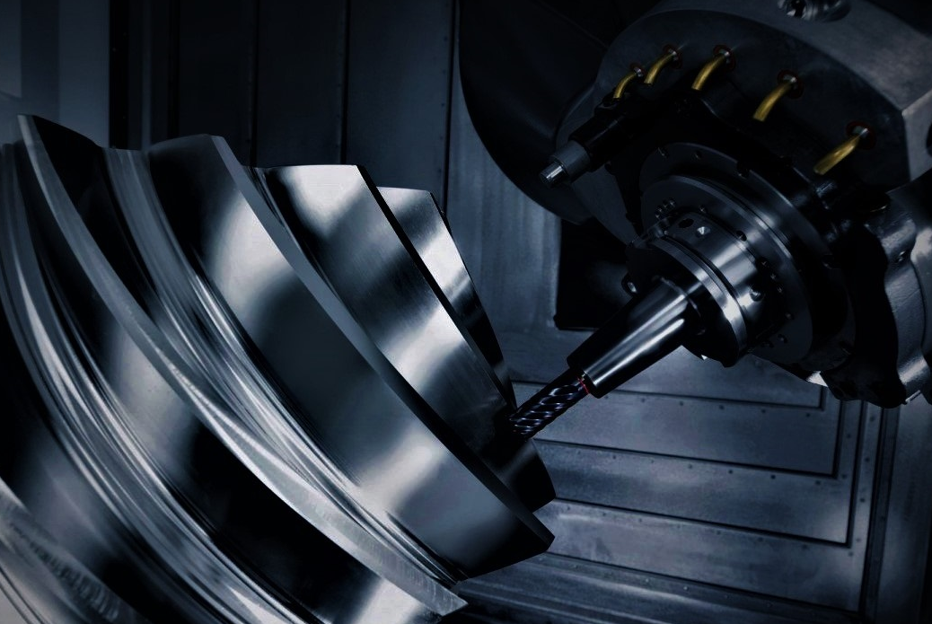
FAMSim 1.0
FIVE AXIS MILLING SIMULATOR

